Slide 1
Unit 4: Customers and Consumers
GAP work: Deadline – September 2024
Use this powerpoint and the crib sheet and unit 4 booklet to help you address P1.
The Nuffield website will also be useful to refer to. https://www.nuffieldhealth.com/about-us/how-we-are-governed/2017-annual-report

Slide 2
Todays Objectives – Unit 4 Customers and Communication
Understand how to use the accompanying documents for this unit
Performance criteria/Structure of the unit
Specification
Model Assignment
Booklet
Crib sheets
Knowledge Organiser
How to present each criteria
Understand how to introduce Unit 4 – refer to Unit 4 booklet
Understand how to carry out P1 – refer to unit 4 booklet, spec and crib sheet

Slide 3
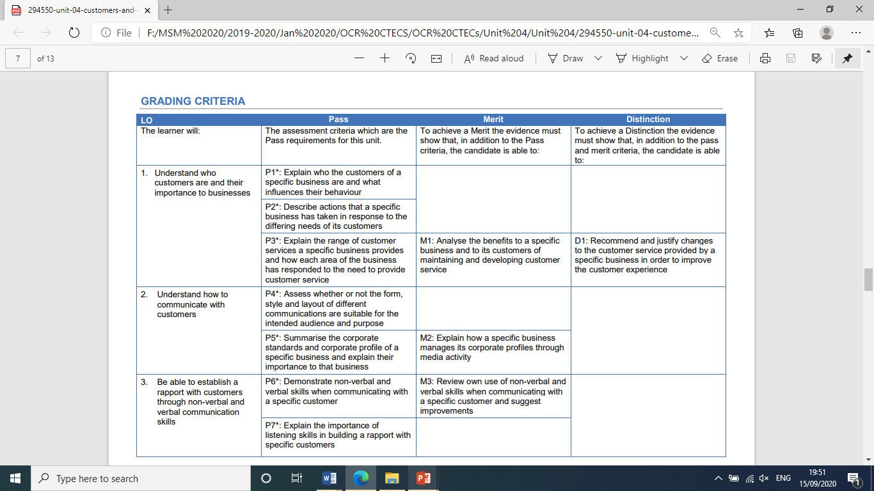
Performance criteria/Structure of the unit

Slide 5
The Specification
Use the Specification as a checklist – if it says i.e. you must include it.
If it says e.g. only use what's applicable
P1
P2

Slide 6
How to Present each criteria
Header
Full criteria as a title
If these are not there, your work is sent back to you.
Avoid using bullet points from the Spec

Slide 7
Supporting documents and starting the unit
Crib sheet – this is a guide only
Booklet – guides you through the unit and criteria
Knowledge Organiser – basic explanations of the concepts/key words within the unit
The book - Cambridge Technicals Level 3 Business (Hodder Education)
Starting the Unit
Understand how to introduce Unit 4 – refer to Unit 4 booklet – Deadline Tuesday 22nd Sept (before the lesson)
Understand how to carry out P1 – refer to unit 4 booklet, spec and crib sheet – Deadline Fri 2nd October
For each criteria – email me the work – smithm3

Slide 8
Unit 4: Customers and Consumers
P2: describe actions that a specific business has taken in response to the differing needs of its customers
Break this down:
P2: describe actions that a specific business has taken in response to the differing needs of its customers –
Deadline – Friday 9th October

Slide 9
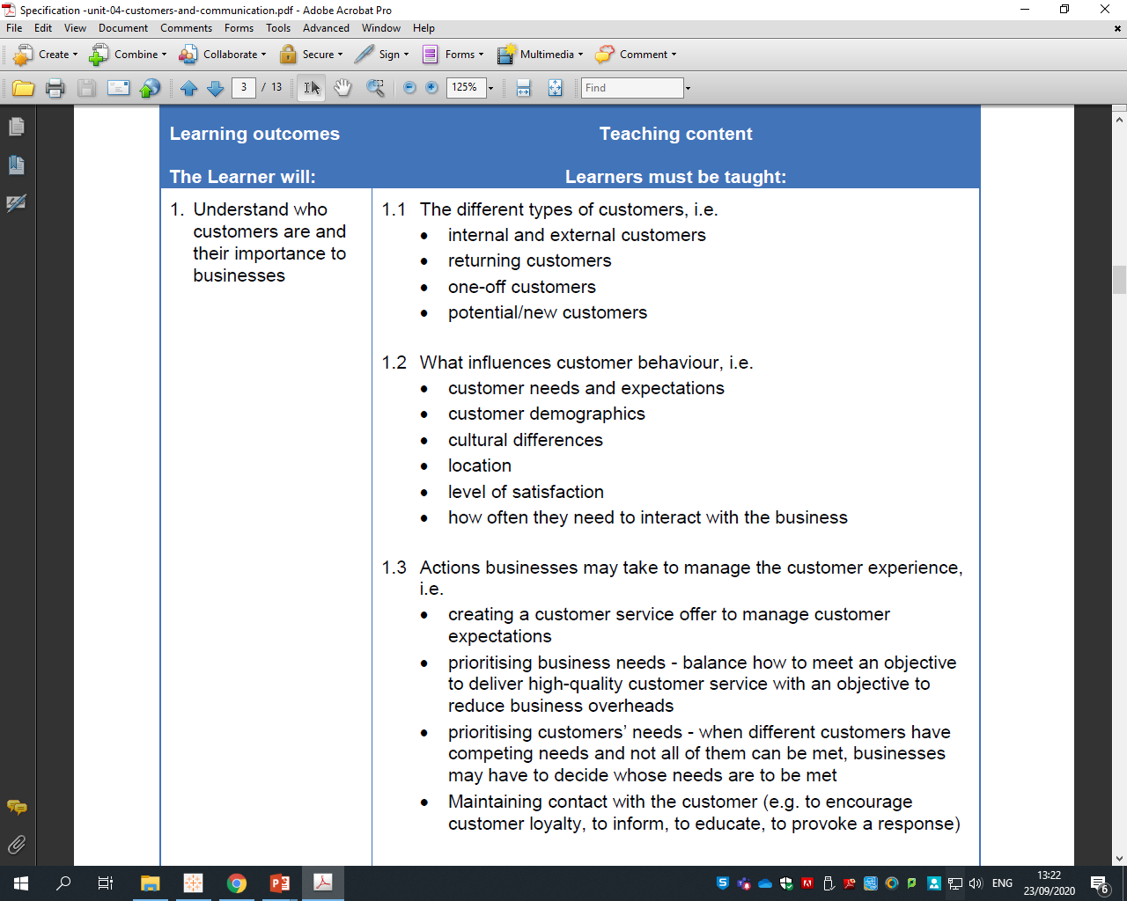
P2: describe actions that a specific business has taken in response to the differing needs of its customers
P2

Slide 10
How can we present this?
Task 3: The Business Response to differing customer needs P2
In this section you could create a table such as the one below.
Customer Type | Specific Needs/Expectations | Business Response
Internal (give examples) | Recap their needs/expectations as identified in task 2. | Explain (with examples) what actions the business has taken in order to meet the needs/expectations of this specific customer.
External (give specific examples)

Slide 11
Unit 4: Customers and Consumers Wed 30th Sept
P2: describe actions that a specific business has taken in response to the differing needs of its customers Deadline – Friday 9th October
P3: Explain the range of customer services a specific business provides and how each area of the business has responded to the need to provide customer service
Deadline: Tuesday – 13th October
Break this down:

Slide 12
Unit 4: Customers and Consumers Wed 30th Sept
P3: Explain the range of customer services a specific business provides and how each area of the business has responded to the need to provide customer service
Deadline: Tuesday – 13th October
What is the difference between customer facility and customer service?
What does each are of the business mean? – think about the gym itself!!
(Refer to the crib sheet)
Show an exemplar – how it can be set out
Show Nuffield Photos – where is the customer service

